Slide 1
resentation by:
Yashwanth gopi:22j41A6691
Devraj:22j41A6692
Asmitha Nandu:22j41A6693
Vinay Kumar:22j41A6694
Akash:22j41A6695
Department of computer science and engineering(aiml)
Malla Reddy Engineering College(Autonomous)
Maisammaguda Dhulapally(po)
Secundrabad 500100

Slide 2


MEDICINE RECOMMENDER

Slide 3
ABSTRACT:
This project is a Medicine Recommender system with a web interface that allows users to submit and search for information on diseases, associated medicines, and symptoms. The system comprises three HTML pages: "addinlist.html" for submitting new data, "addinlist2.html" for adding medicines to a table dynamically, and "index.html" for displaying a predefined table of diseases, medicines, and symptoms. The data is stored in a Google Sheets document using Google Apps Script, enabling real-time updates.Users can search for diseases, medicines, and symptoms using input fields with live filtering. The system also includes a dynamic table where users can add and save medicines for different diseases. The design emphasizes a user-friendly interface with color-coded elements. The project provides a valuable resource for individuals seeking information on diseases and their associated treatments, promoting awareness and facilitating data-driven decision-making in healthcare.

Slide 4
EXISTING SYSTEM:
Existing medicine recommender websites leverage sophisticated algorithms and medical databases to provide personalized recommendations. Platforms like Medscape, WebMD, and Drugs.com analyze user input, considering symptoms, medical history, and preferences. These websites offer valuable insights into medication interactions, dosage guidance, and potential side effects. Additionally, they often include features such as drug comparisons and information on over-the-counter alternatives. With user-friendly interfaces, these platforms empower individuals to make informed decisions about their healthcare, promoting accessibility to accurate medical information and enhancing overall well-being.

Slide 5
PROPOSED SYSTEM:
The proposed system for this project aims to create a Medicine Recommender system with an improved user interface and additional features. The system comprises three interconnected HTML files: "addinlist.html" for submitting new medicines, "addinlist2.html" for manually adding medicines to a table, and "index.html" for displaying a searchable list of diseases, medicines, and symptoms. The integration with Google Sheets is facilitated by a server-side script written in JavaScript ("sheet.js"). The system enables users to input, submit, and search for medical information effectively. Additionally, "style.css" enhances the visual appeal and responsiveness of the interface. Users can submit new data through a form, manually add medicines to a table, and search for information on diseases, medicines, and symptoms. The system emphasizes data integrity and provides warnings to prevent data loss. Overall, the proposed system offers an improved and user-friendly platform for managing and accessing medical information.

Slide 6
SOFTWARE AND HARDWARE REQUIREMENTS:
This project, which appears to be a Medicine Recommender system, primarily relies on software components. The software requirements include a web browser to access and interact with the user interface, a text editor or integrated development environment (IDE) for modifying and creating HTML, CSS, and JavaScript files, and a Google account for utilizing Google Sheets and Google Apps Script. Additionally, the project involves client-side scripting with JavaScript for form submission and data manipulation.On the hardware side, the requirements are minimal. Any device capable of running a modern web browser, such as a computer, laptop, tablet, or smartphone, can access and use the Medicine Recommender system. Since the project relies on cloud-based services like Google Sheets and Apps Script, there is no need for high-performance hardware. However, a stable internet connection is essential for seamless data submission and retrieval.

Slide 7
PROJECT DETAILS:
This project is a Medicine Recommender system implemented through a web interface. Users can submit new medicines and associated information (disease, symptoms) through a form, which is then stored in a Google Sheets document using Google Apps Script. Additionally, there's a dynamic table in another HTML page where users can manually add medicines, and the data is displayed in a tabular format. The main page provides a search functionality for diseases, medicines, and symptoms. The project aims to assist users in finding relevant medicine information and serves as a collaborative platform for updating and sharing medicinal data.

Slide 8
>>>HTML
The project consists of three HTML files. "addinlist.html" features a form to submit medicine data, styled with a green-themed table. It uses JavaScript to send form data to a Google Sheets API. "addinlist2.html" has a table for manually adding medicine data, with a warning not to refresh before saving. It utilizes JavaScript to dynamically add rows to the table. "index.html" displays a medicine recommender interface with a search feature. The table contains predefined disease, medicine, and symptom data. The project also includes "sheet.js" for Google Sheets integration and "style.css" for styling consistency. Overall, the HTML files create a comprehensive medicine recommender system.

Slide 9
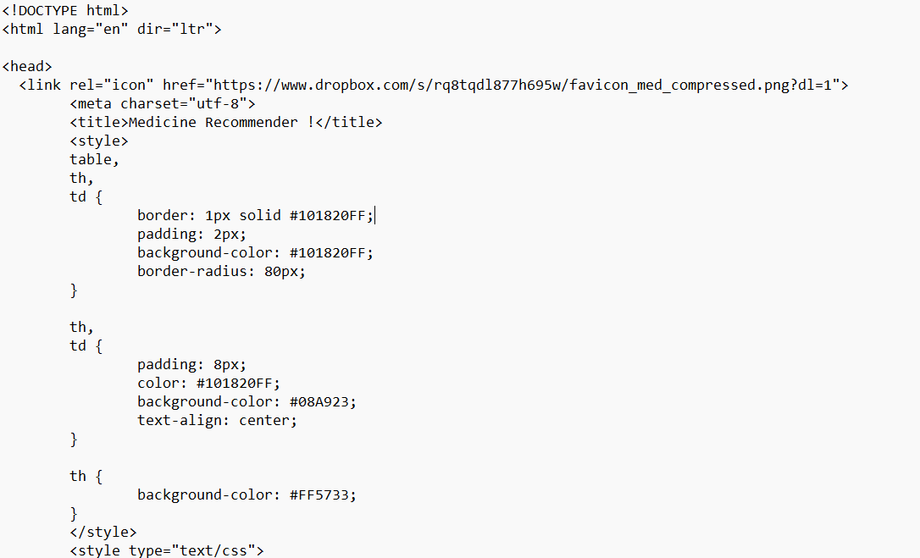
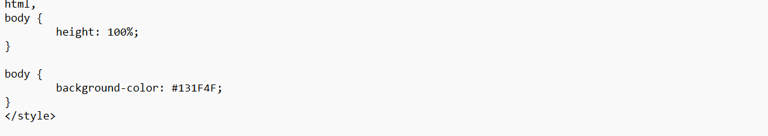

Slide 10
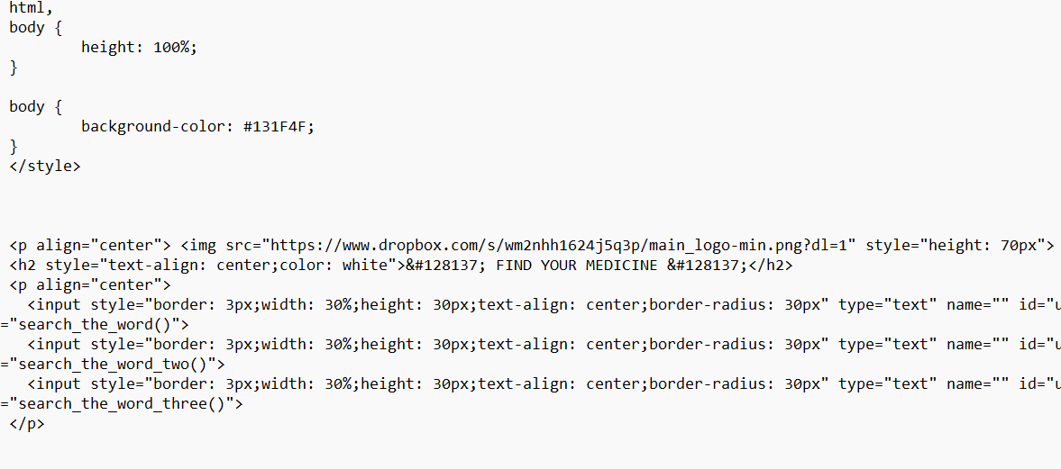

Slide 11
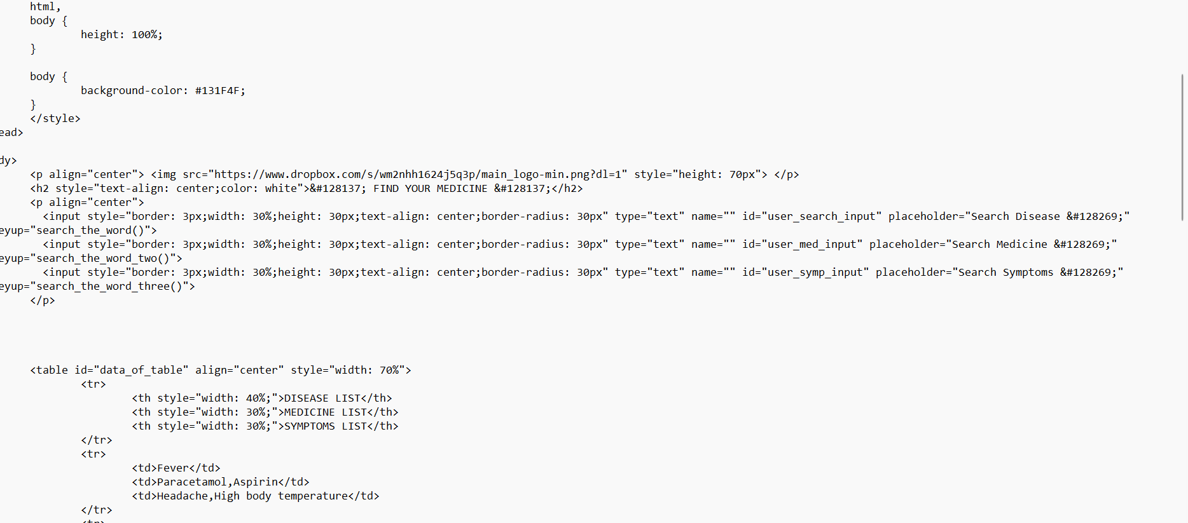

Slide 12
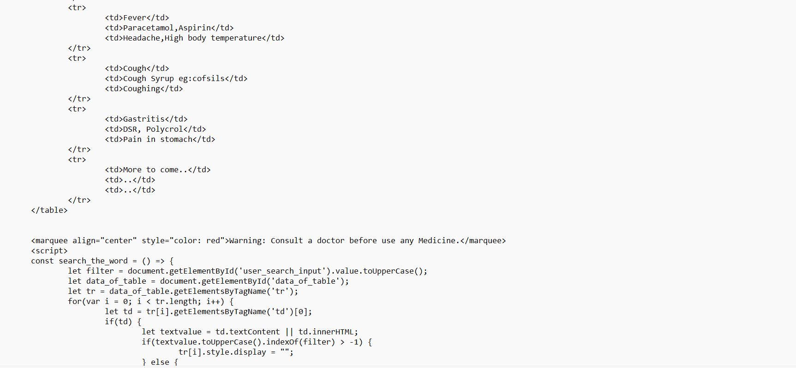
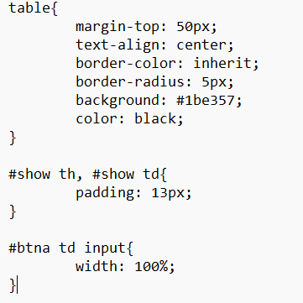

Slide 13
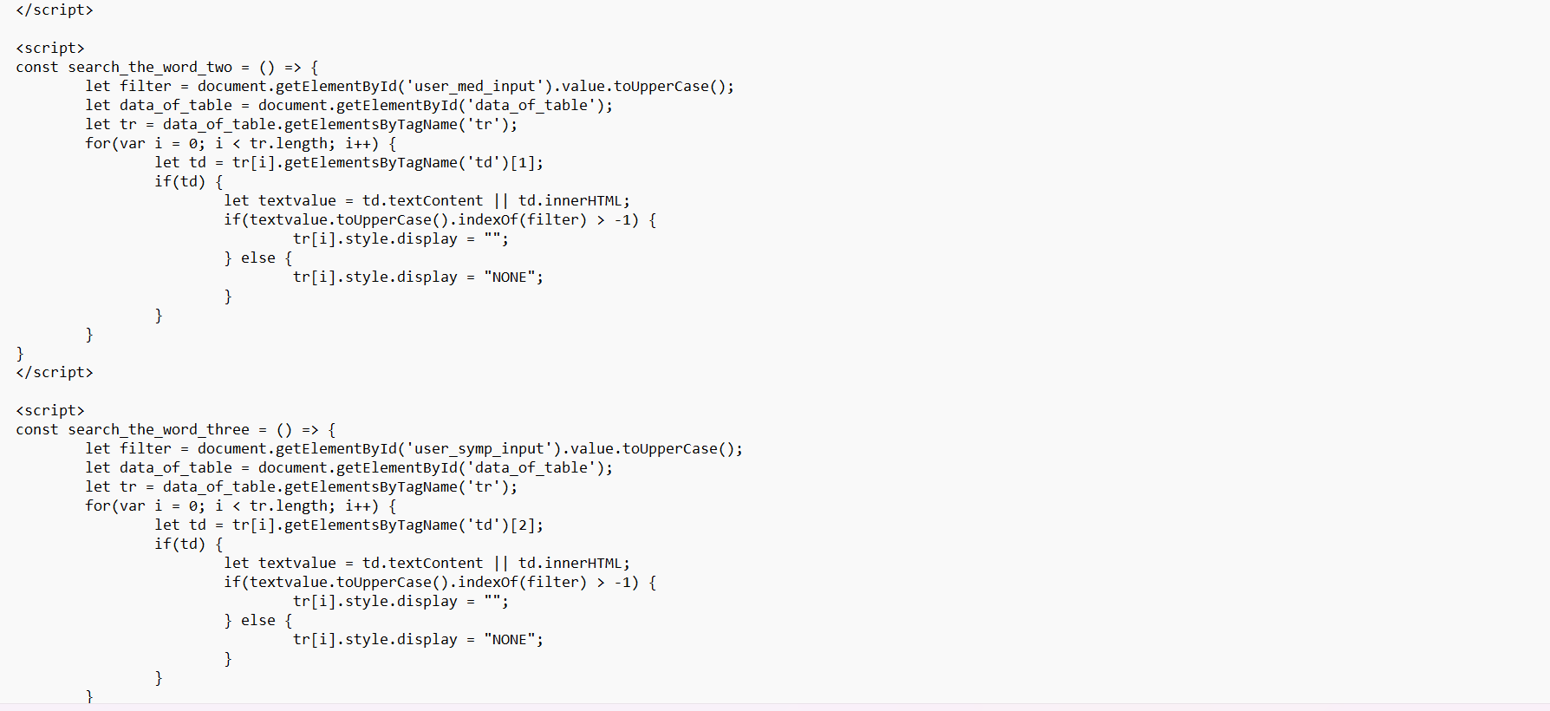


Slide 14
>>>JAVA SCRIPT:
The JavaScript files in this project serve various functions. "addinlist.html" contains a form submission script that sends data to a Google Sheet through a Google Apps Script. The script ensures data integrity and provides a submission confirmation. "addinlist2.html" allows dynamic addition of rows to a table, storing user-inputted data in arrays, and preventing accidental page refresh. "index.html" incorporates search functionalities for a static data table, allowing users to filter diseases, medicines, and symptoms. "sheet.js" handles the backend logic for receiving and storing form submissions in a Google Sheet. The CSS files enhance the visual appeal and styling of the HTML elements.

Slide 15
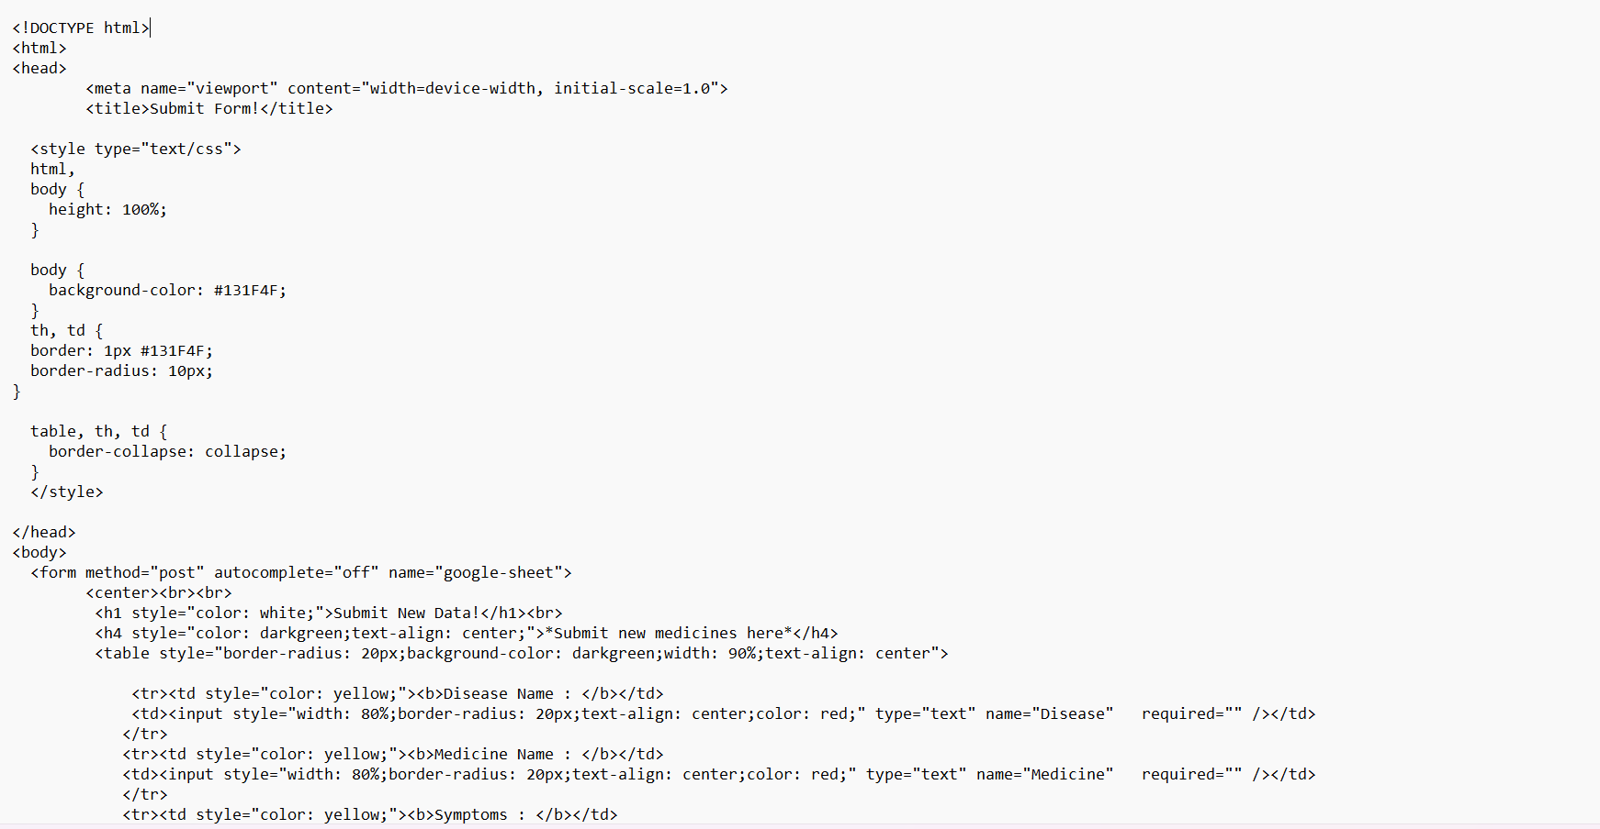

Slide 16
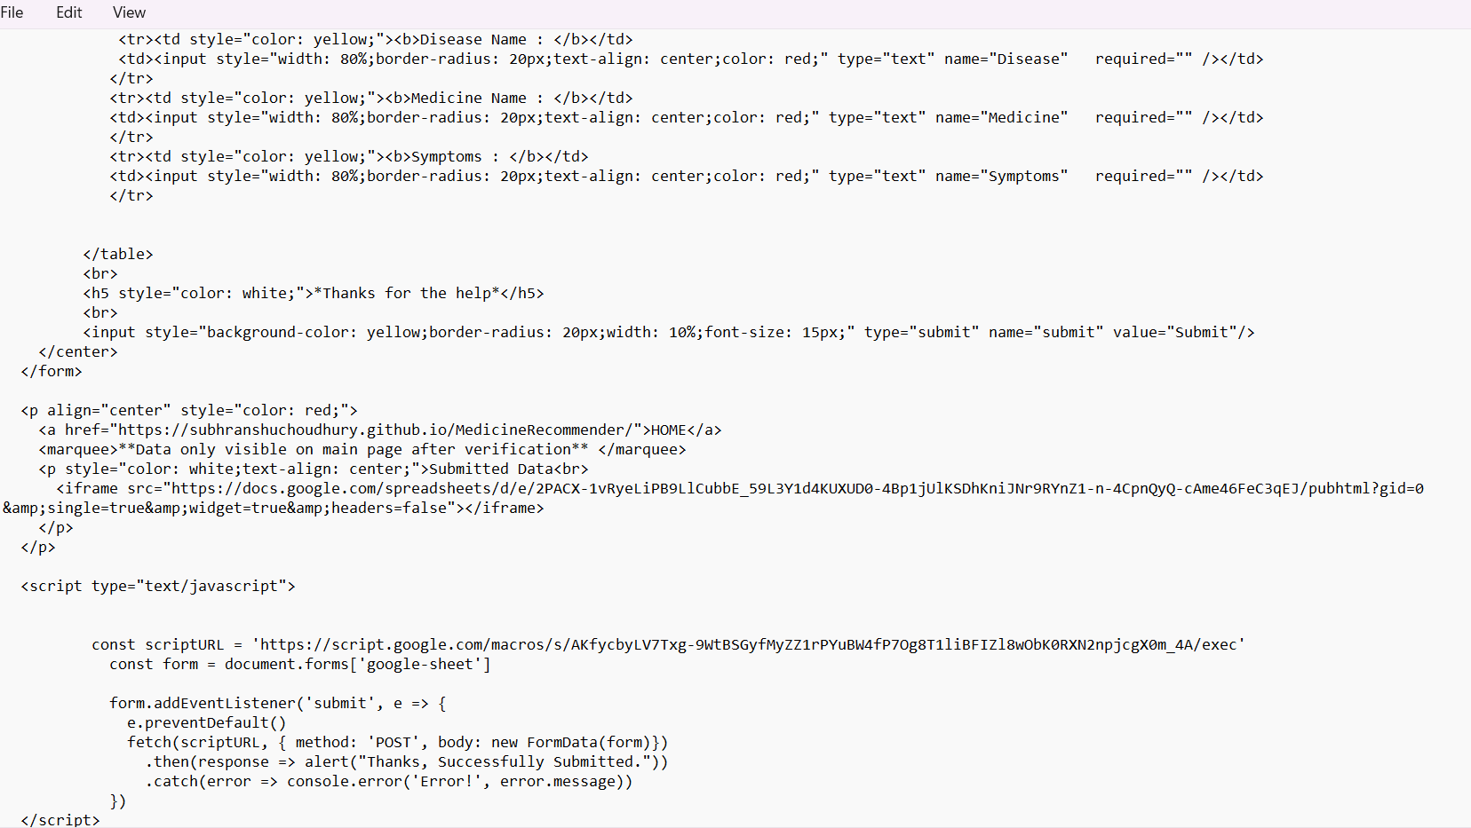


Slide 17
>>>CSS:
The CSS files in this project play a crucial role in styling the HTML elements, enhancing the visual appeal, and ensuring a consistent and user-friendly design. In "addinlist.html," the styling includes responsive design features, color customization for form elements, and table formatting. "addinlist2.html" employs CSS for centering elements, styling tables, and creating a visually appealing interface for adding medicines. Finally, "index.html" focuses on styling tables, input fields, and providing a visually pleasing color scheme. Additionally, "style.css" contributes to the overall aesthetics, setting margins, aligning elements, and maintaining a cohesive design across different HTML files for a harmonious user experience.

Slide 18
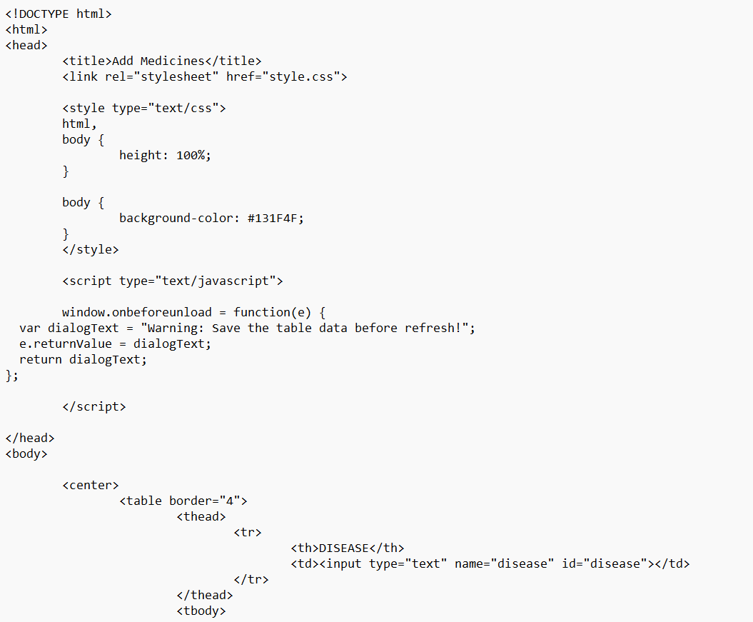

Slide 19
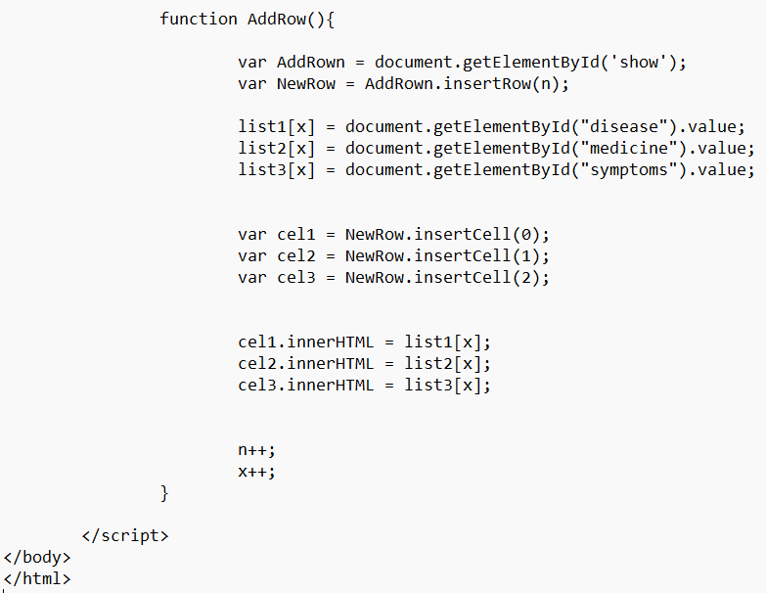

Slide 20
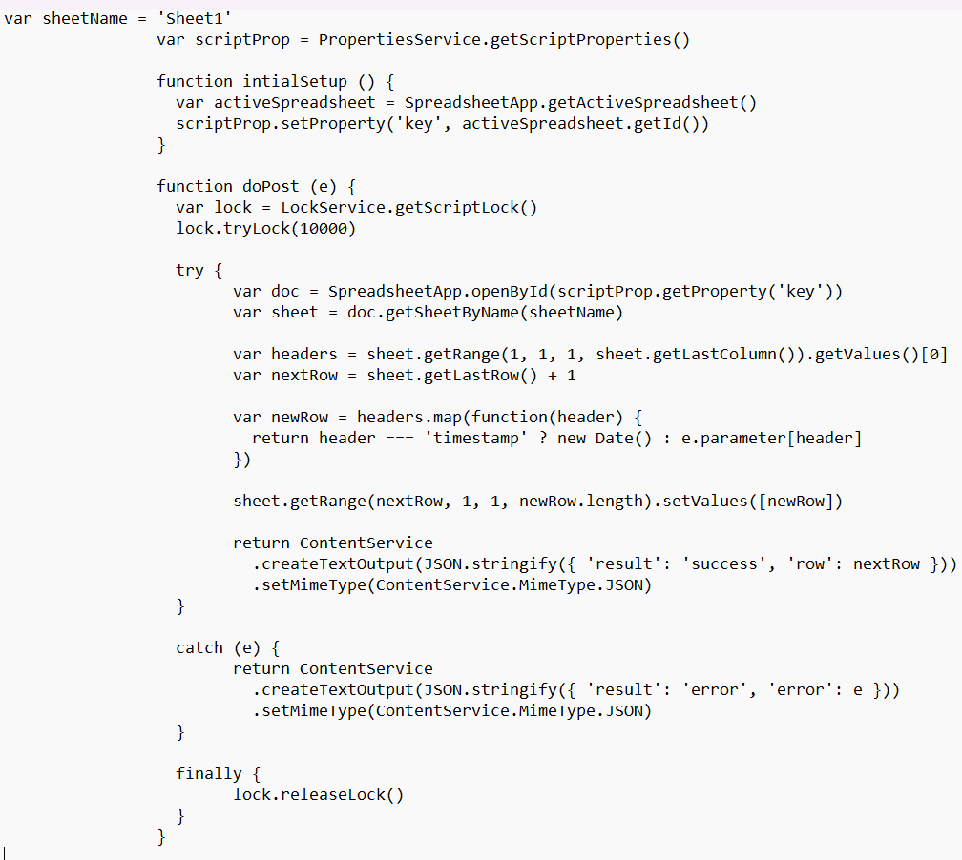

Slide 22
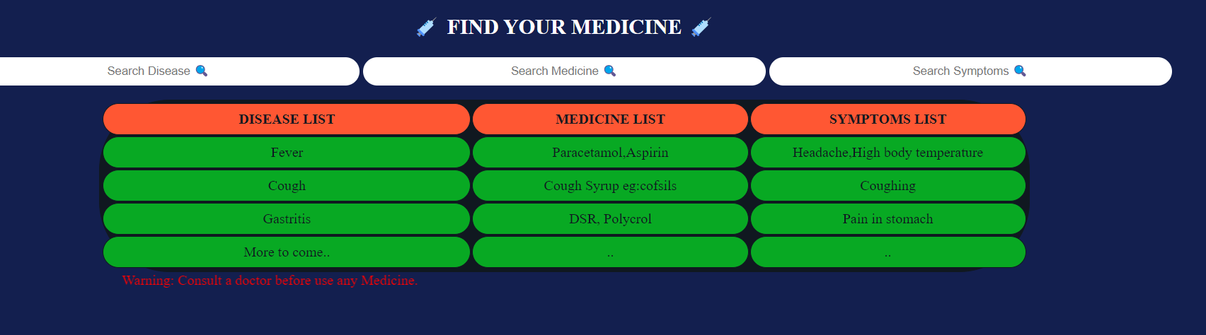

Slide 23
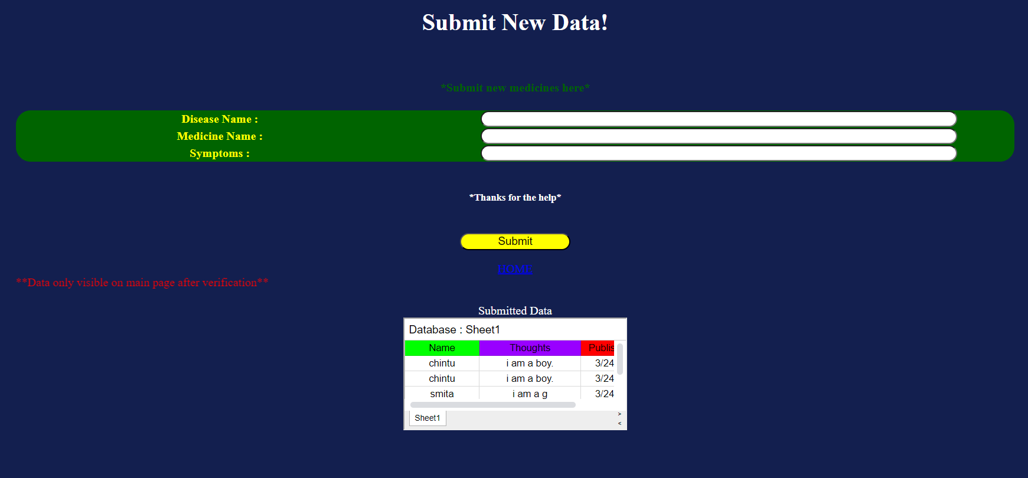

Slide 24
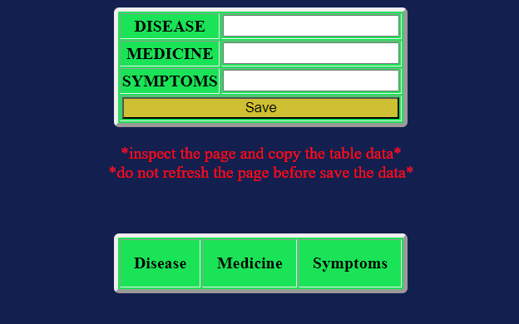

Slide 25
CONCLUSION:
In conclusion, this project offers a comprehensive solution for managing and recommending medicines. The "Submit Form" feature allows users to contribute new data, enhancing the database dynamically. The "Add Medicines" section facilitates data entry with real-time table updates. The main page provides a user-friendly interface for searching diseases, medicines, and symptoms. The Google Sheets integration ensures secure data storage. With a visually appealing design and thoughtful functionalities, this project serves as an effective platform for sharing and accessing medical information. However, it's crucial to consult a doctor before using any medicine, emphasizing the project's commitment to user safety and health.

Slide 26
THANK YOU !!

